Slide 1
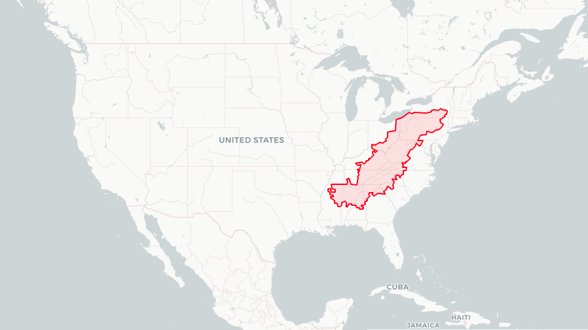
Ben Aiken MUSA Capstone 2022 Distributing Broadband in Appalachia

Slide 2
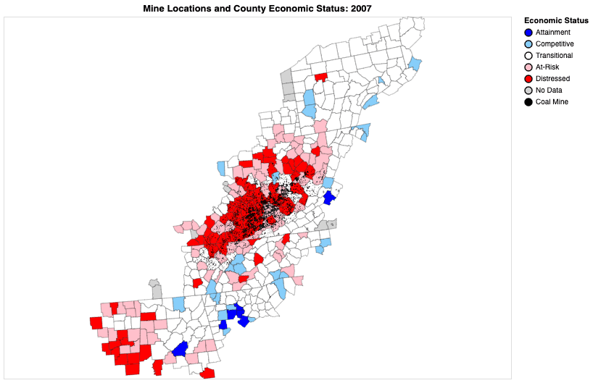
Appalachia is in Distress
Since 2012, 300 coal-fired power plants have closed
A win for the environment
But a loss for workers: 44,000 coal mining jobs eliminated
These coal mine towns are in economic turmoil
Notes:
Quick Motivation

Slide 3
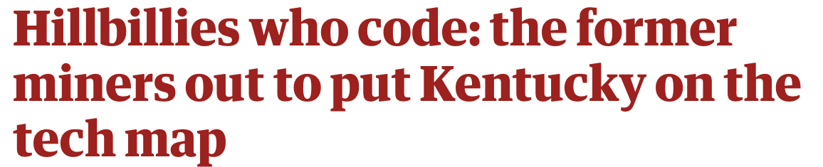
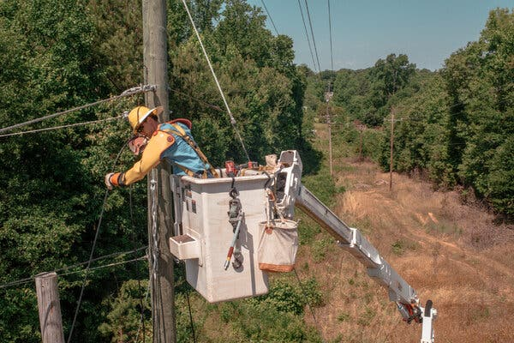
Internet: The path to economic recovery?
Can the “Silicon Holler” be the next tech hub of the United States?
“All of a sudden, the internet is no longer optional. You can’t participate in this economy without access to the internet.”
- Eric Schmidt (former CEO of Google)
Notes:
Display statistic of nationwide internet access and nationwide broadband compared with app internet access and nationwide internet access

Slide 4
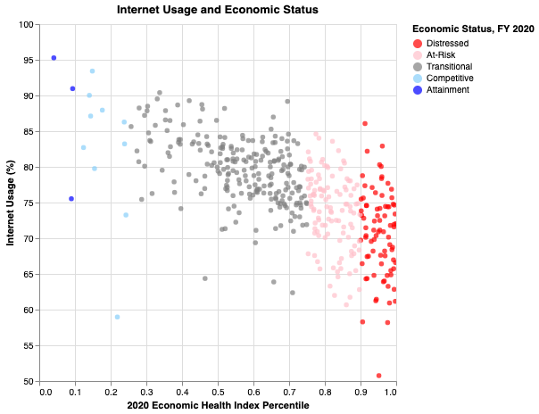
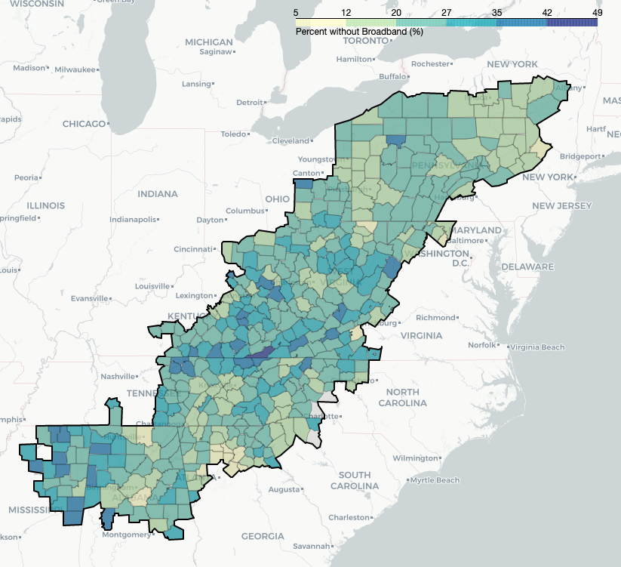
Broadband in Appalachia
Counties with the lowest economic index have the least internet usage.
Notes:
Graph of economic index compared with access to broadband or usage of broadband

Slide 5
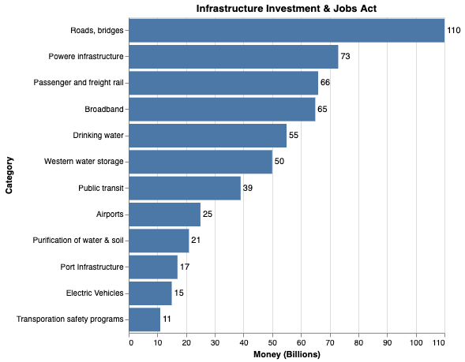
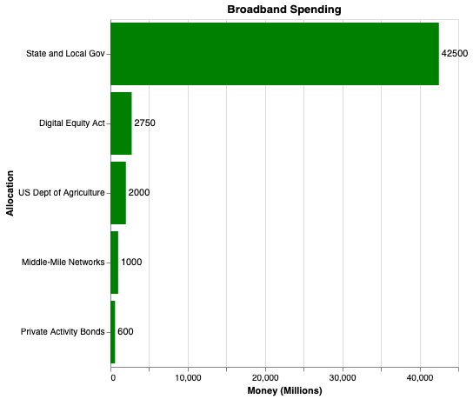
Question
How should the broadband resources of the Infrastructure Investment and Jobs Act be distributed in Appalachia to spur the greatest economic impact?

Slide 6
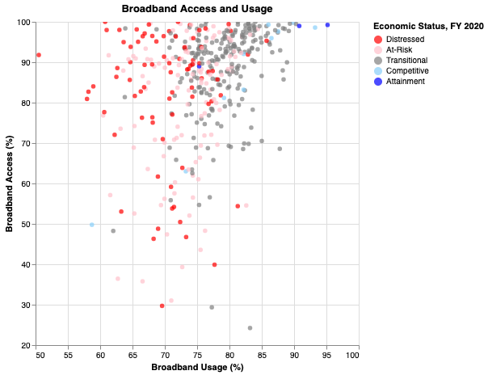
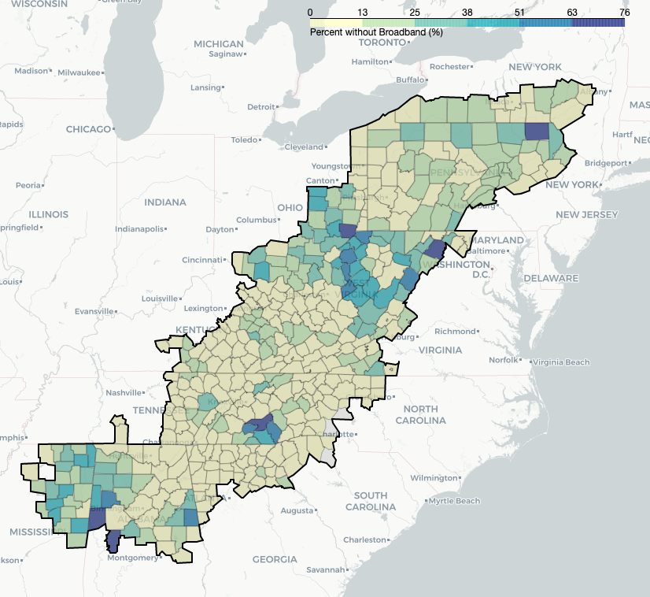
Current Accessibility
Many counties have high access to broadband, but low usage suggesting economic challenges beyond infrastructure.
Notes:
Map of accessibility
Graph of cost compared with usage

Slide 7
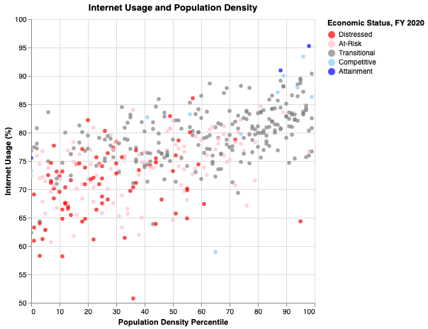
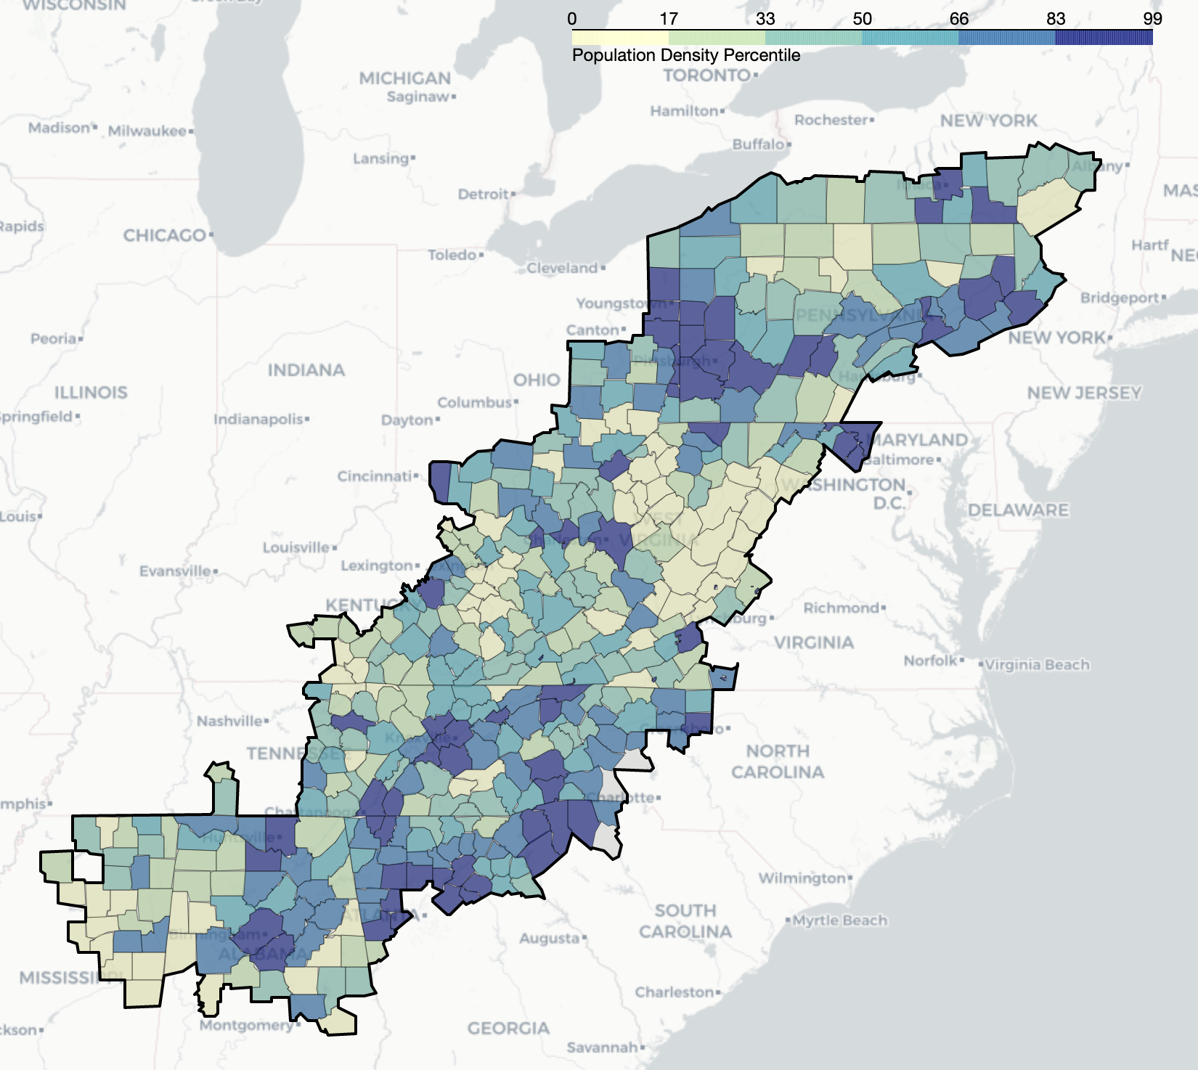
Population Density
Denser regions use more internet.

Slide 8
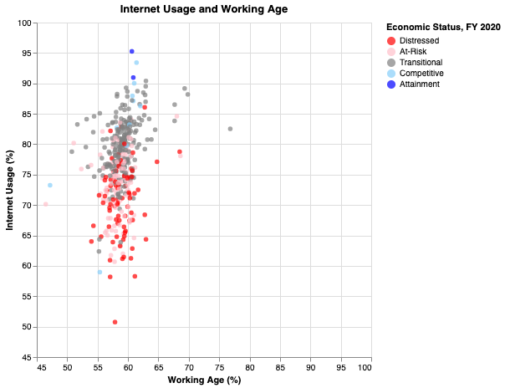
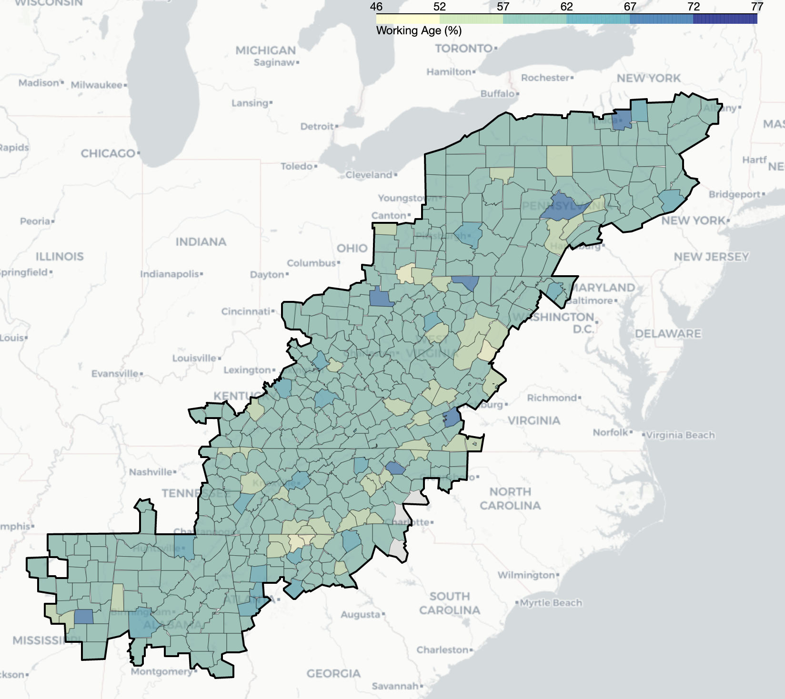
Working Age
Age lacks clear trends spatially and in relation to internet usage.

Slide 9
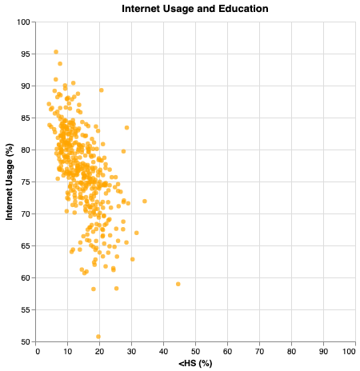
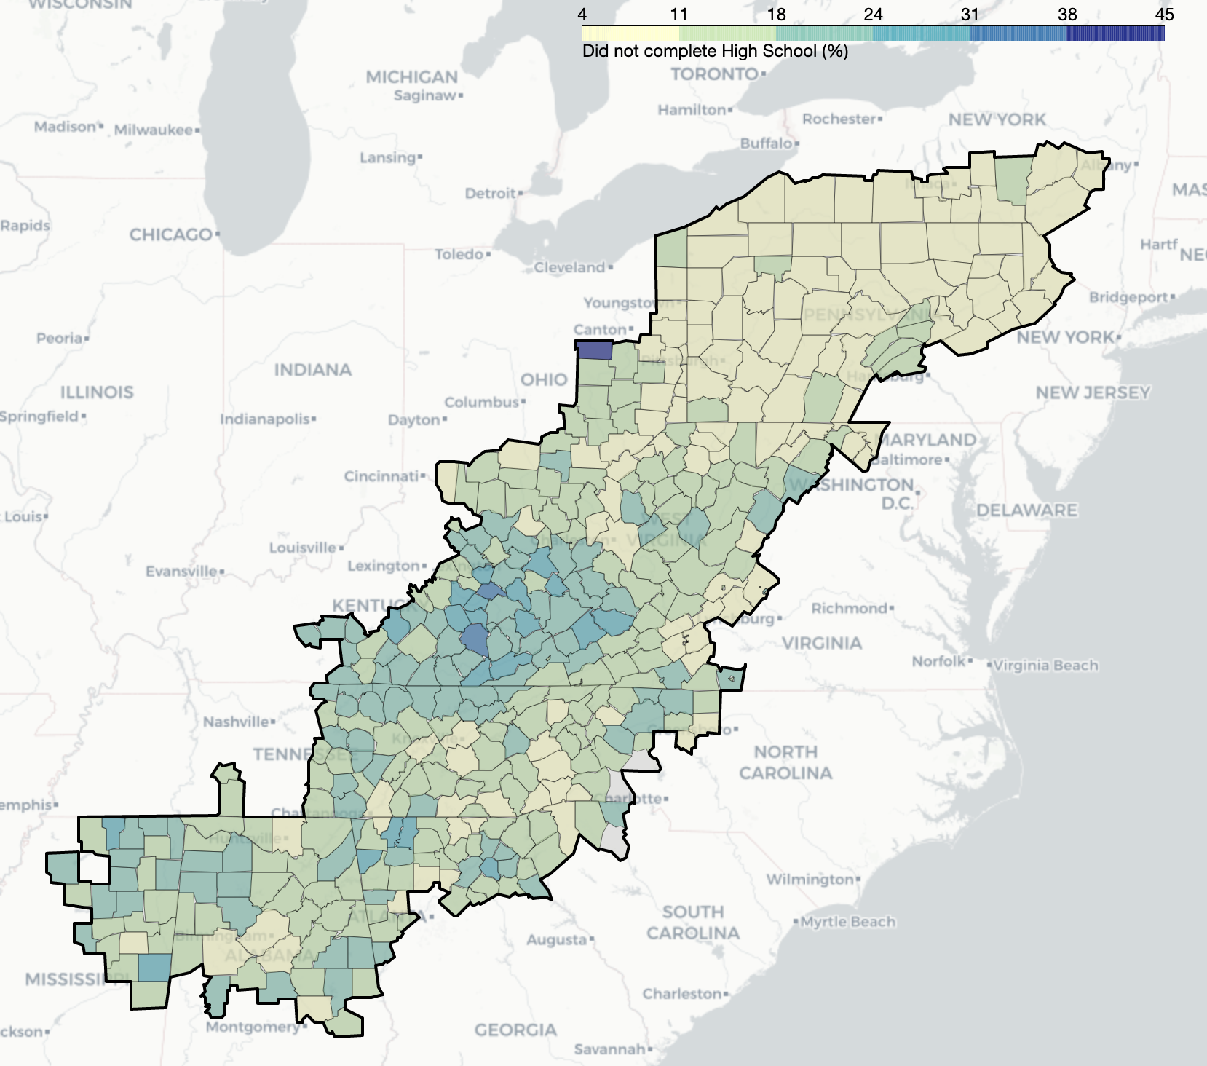
Education: Less than High School
As college graduation rates increase, internet usage increases as well. The same is not true for high school graduation and drop out rates.

Slide 10
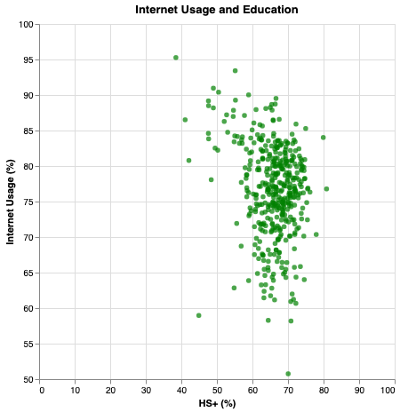
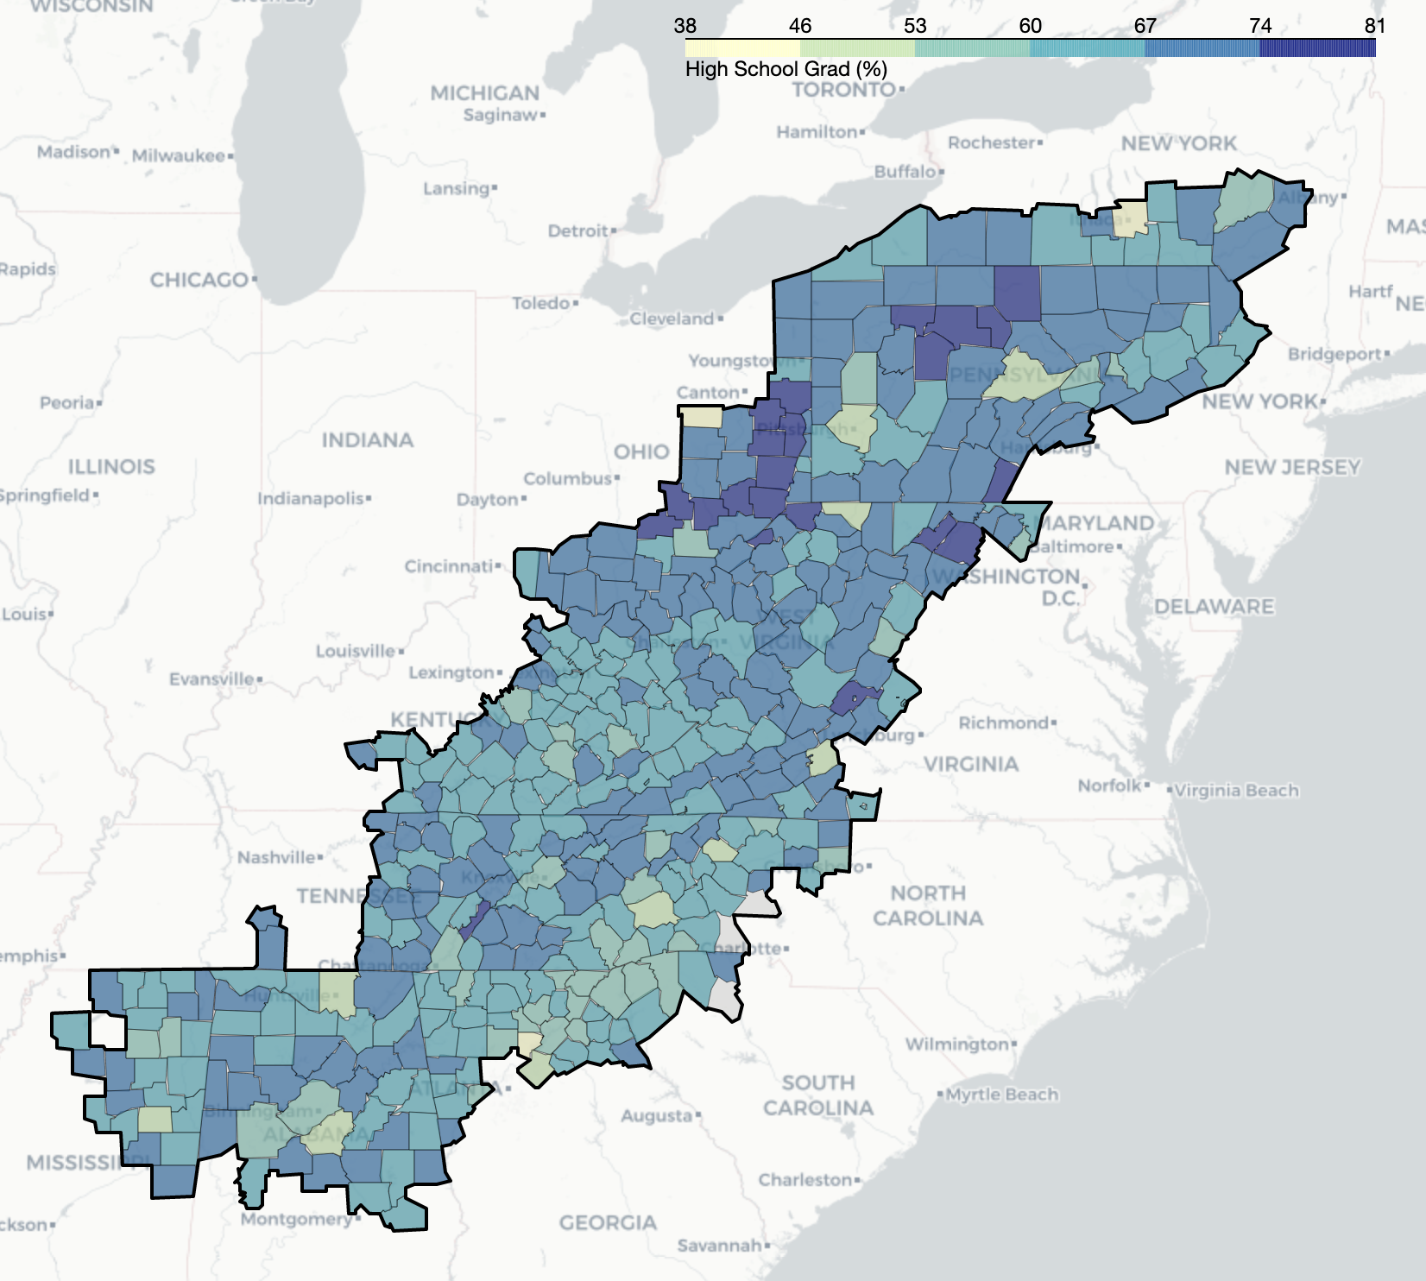
Education: At least High School
As college graduation rates increase, internet usage increases as well. The same is not true for high school graduation and drop out rates.

Slide 11
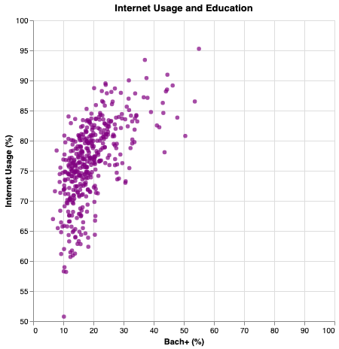
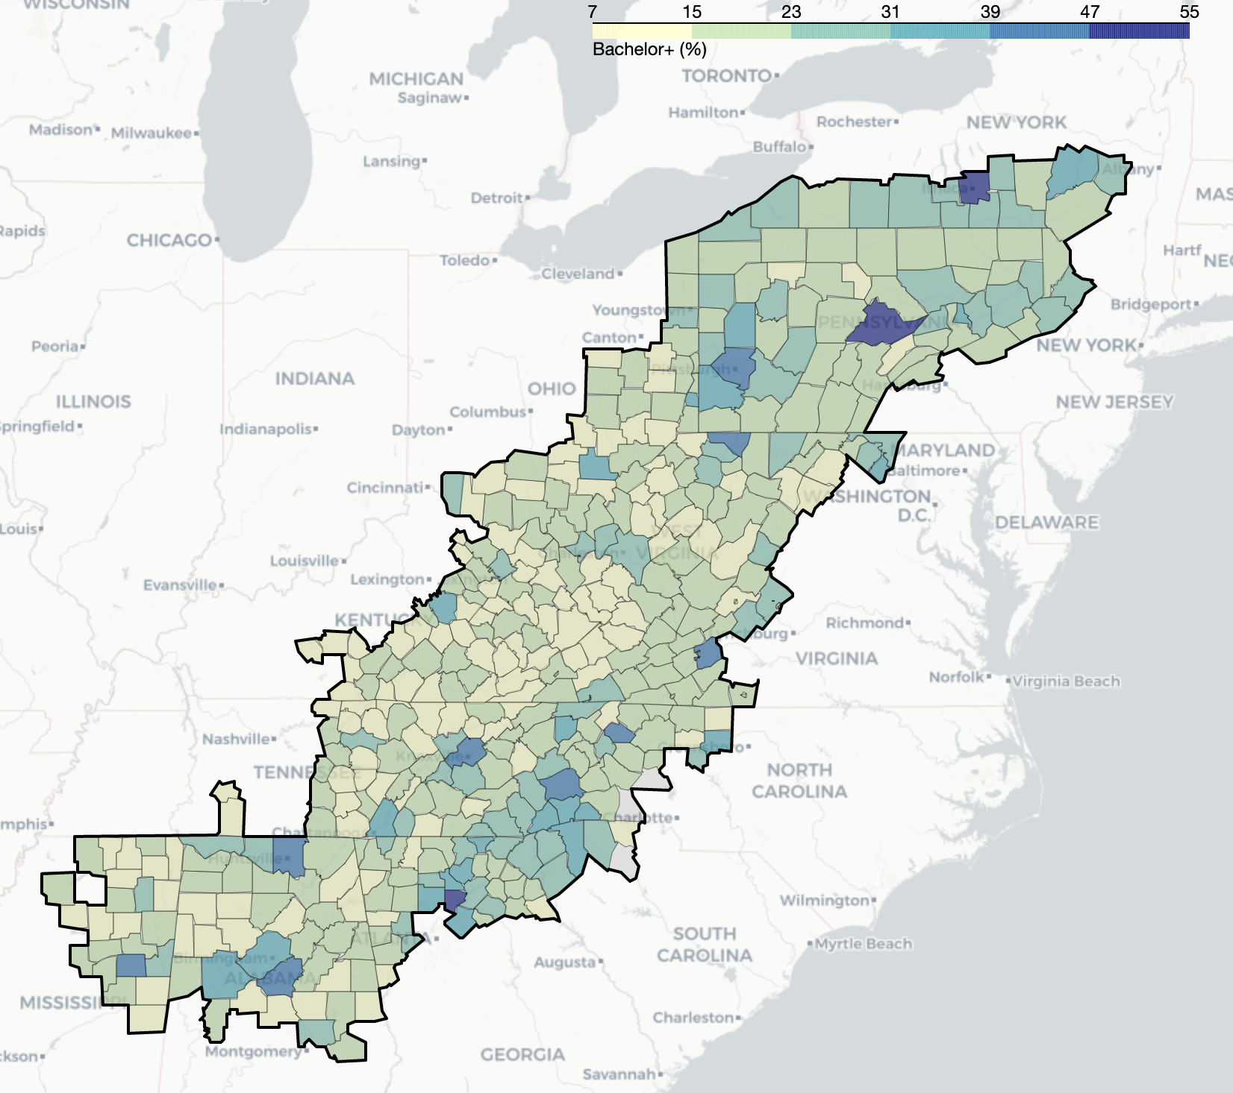
Education: At Least College
As college graduation rates increase, internet usage increases as well. The same is not true for high school graduation and drop out rates.

Slide 12
Infrastructure Priority Index
The following factors are used to derive a broadband impact index:
Demographics
Population density
Percent of population at working age
Cost of implementation
Proximity to current infrastructure
Topography
Economic Status
Economic Health Index as established by the Appachalian Regional Commission
Education
Current achievement levels
Access to higher-ed
Current Access
Access to internet and type of internet

Slide 13
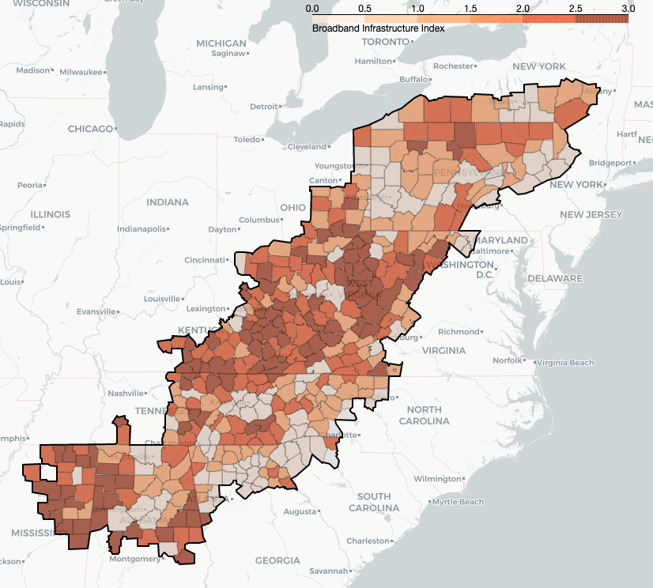
Infrastructure Priority Map

Slide 14
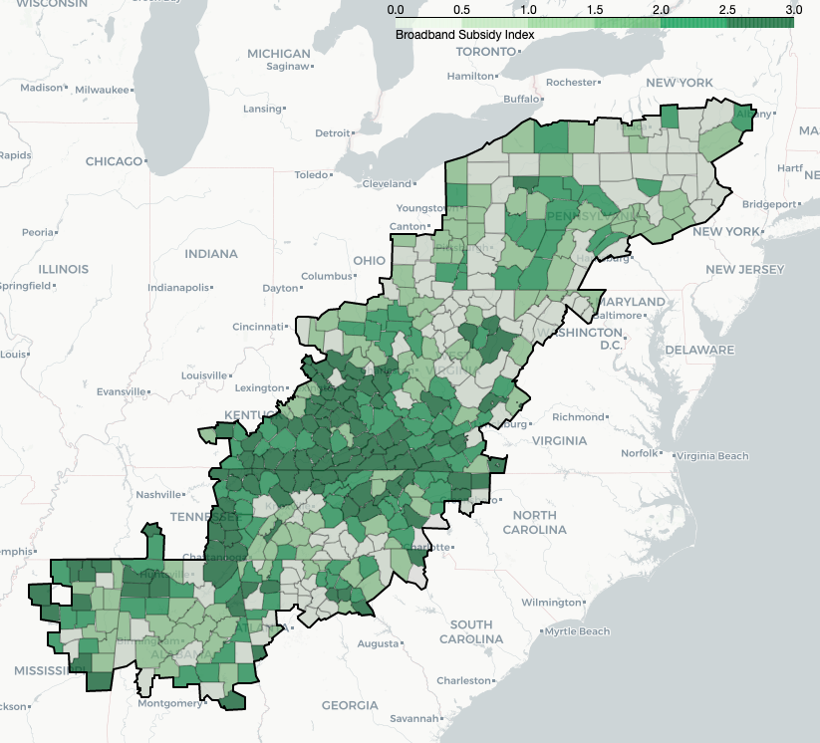
Broadband Subsidy Index & Map
A portion of the Infrastructure Bill is dedicated to subsidizing internet costs.
Subsidy Index Factors:
Access (high)
Usage (low)
Working Age (high)
Notes:
Cost of broadband vs economic distress

Slide 15
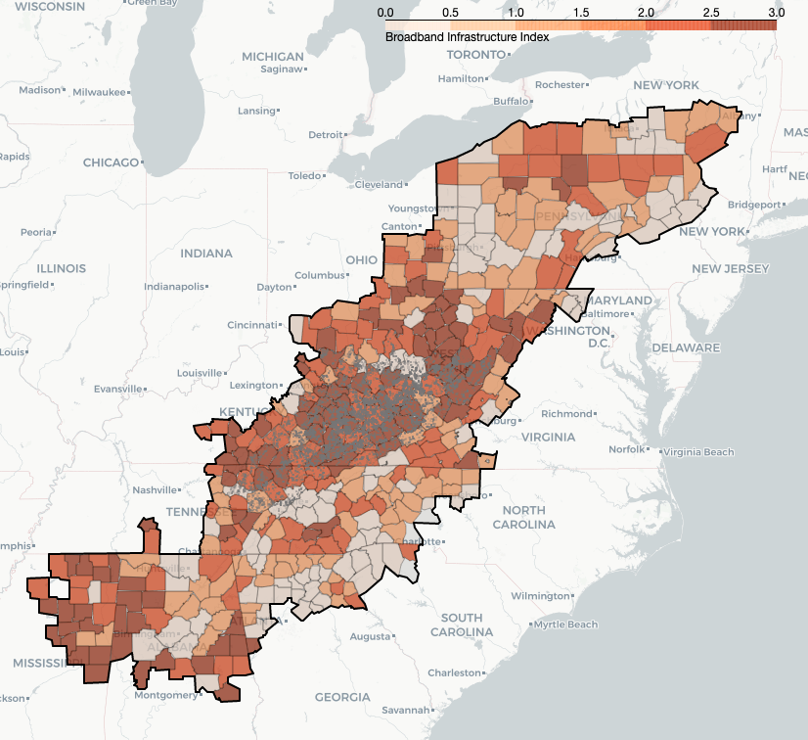
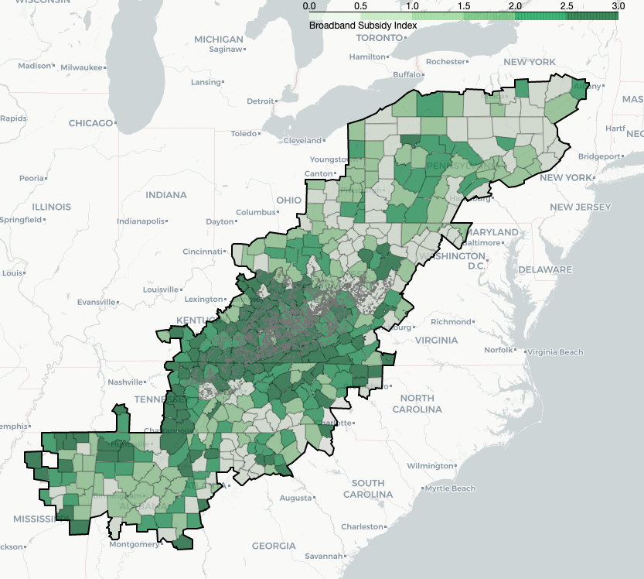
Infrastructure and Subsidy vs Mines

Slide 16
Data Sources
Appalachian Regional Commission’s economic distress index
Demographic data came from the 2020 American Community Survey
Internet Access data was provided by BroadbandNow
Education Access data was sourced from IPEDS

